Slide 1



ENERGY MANAGEMENT
Data ANALYTICS HYBRID SYSTEM
Presented to RSS Hybrid Solutions

Slide 2
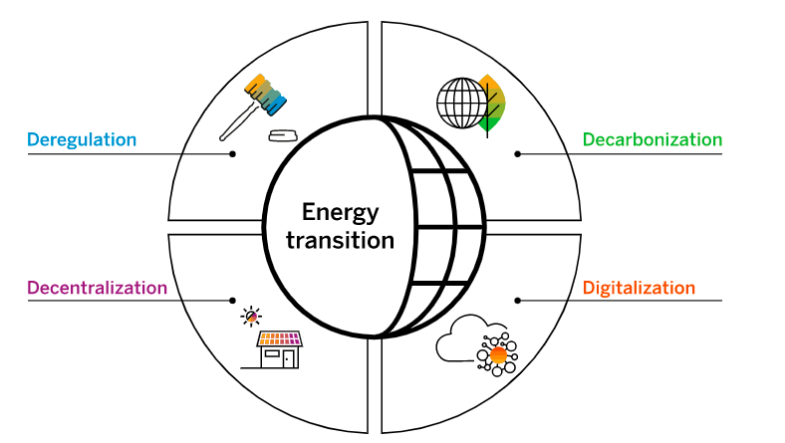
Why Energy management Important
Energy deregulation
The once-stable energy industry is now being disrupted by new players. Utilities must digitalize their legacy systems or risk losing out to more agile competitors that can leverage DER, decentralized networks, and handle energy at the “grid edge.” By modernizing, traditional providers can diversify their business models and gain new revenue streams.
Decarbonization challenges
Renewable energy is increasingly affordable and attractive. But as utilities transition into sustainable energy companies, they face new challenges – such as variability in weather-controlled power generation and the impact on demand models. They need accurate, real-time data to efficiently deliver the clean energy that customers are demanding.
Decentralization
Distributed energy resources (DER)– including rooftop solar systems, battery storage, and electric vehicle chargers – are owned by prosumers, who expect their utility bill to reflect both the power they use and the power they generate. Now, billing must evolve from merely a means of collection to a point of interaction and customer communication.
Digitalization: key to resilience
With weather disasters at an all-time high, grid resilience is critical. But energy companies with aging physical assets and paper-based legacy systems can’t leverage innovations that boost reliability – such as smart grids, smart metering, and local energy balancing. What they urgently need is an intelligent, integrated, cloud-based system.
2

Slide 3
Featured utilities and energy management solutions
SAP E-Mobility
Empower utilities technicians to rapidly resolve issues and boost customer satisfaction with end-to-end field service management from mobile tools to AI-based recommendations.
Track equipment and IoT data in a central repository that makes it easier to collaborate on asset maintenance, usage, and failures – and keep utilities assets performing at their best.
SAP Field Service Management
SAP Asset Intelligence Network
Manage your electric mobility network efficiently on a platform that provides a clear view of charging processes, incidents, energy costs, power grid utilization, and expenses.

Slide 4
SAP Field Service Management
Real-time field service metrics
Make decisions and recognize issues quickly with standardized and customized analytics and report
Observe and analyze key performance indicators that are critical for your tasks and business
Mobile and desktop reporting
Gain a 360-degree view of your customers, connected products, and service staff – all in a single data hub
Access dashboards and graphically enhanced reports on mobile devices, desktops, and offline sources
AI-enabled scheduling
Prioritize important service calls and manage complex shift schedules
Optimize scheduling, planning, and dispatching in real time with AI-based tools
Customize your planning list and view the information that is important for you

Slide 5
SAP Asset Intelligence Network
Collaborative partner relationships​
​
Invite your business partners to the network through a free basic membership to share content and collaborate smoothly with the active support of our enablement team.​
Cloud-based deployment​
​
Get up and running quickly and cost-effectively in the cloud with minimal IT costs, low maintenance, and security management.​
Digital vehicle hub​
​
Unify your vehicle repository along the automotive value chain to secure insights, monetize data, create mobility scenarios, and enable an open partner network.​
Intuitive user experience​
​
Accelerate and simplify user adoption by providing a unified, intuitive user experience based on the SAP Fiori user experience.
Integration with SAP solutions​
​
Connect with other SAP solutions, such as SAP S/4HANA, to facilitate a smooth data exchange across enterprise and plant systems.

Slide 6
The Smart Grid: How AI Is Powering Today’s Energy Technologies
A smart grid is a network that integrates energy distribution and digital communication technology in a two-way flow of electricity and data. This enables utility companies to optimize the generation, transmission, and distribution of electricity.
traditional grid vs smart grid?
Technology: AI, cloud, and digital technologies allow all the devices and assets within the grid to communicate, supporting better control and self-regulation.
Distribution: Energy generated by prosumers and other renewable energy sources – such as solar or wind – can be intermittent and uneven. Smart grid technologies help to coordinate, store, and distribute power from such sources into a steady and reliable stream.
Generation: Predictive analytics in smart systems means that high-demand strains can be forecasted and distributed to multiple plants and substations.
Sensors: IoT sensors across the network can help detect risk early on, redistributing power to decrease outages and help balance loads without direct intervention by operators.
Self-repair and predictive maintenance: Sensors can also be used to detect mechanical problems and do simple troubleshooting and repairs, notifying technicians when necessary, based on real-time feeds.
Customer choice: More energy suppliers, cooperatives, and micro-generators can join the grid, allowing consumers to have more choice in how they receive energy.

Slide 7
applications of AI and machine learning in smart grids include
Agility and resilience: When renewable energy is generated by new partners like cooperatives and prosumers, it is often intermittent and variable. Sensors and automation can be used to identify parts of the grid that are vulnerable and respond with automated rerouting – storing surplus energy during peak generation times and rerouting it during gaps in the flow.
More precise forecasting: The utilities sector faces widespread price variability due to changes in consumption. Predictive analytics models can be used to more reliably predict power loads and renewable energy generation. By combining data from advanced metering infrastructure (AMI) with AI, predictions are more accurate than traditional approaches.
More sophisticated outage alerts: The network of sensors, meters, and actuators in a smart grid can give a “last gasp" short signal transmission, including time and date, to indicate a loss in power due to partial or complete outages. In addition, the predictive capabilities of AI and the real-time data of smart meters can notify operators of outages right before they happen. These systems can even differentiate between individual, street, and zonal outages.
Optimized power yield: The use of AI-powered sensor networks in generation stages can also be used to optimize power output. In a similar way, solar energy also benefits from AI tools to increase productivity by predicting solar radiation.
Improved automated switching: The ability of AI tools to predict grid imbalances and to differentiate between a brief power interruption and a full-on outage will soon allow switching protocols to be automated. This will allow utility companies to reroute energy or isolate affected areas before severe damages occur or the outage expands to other areas. These tools are a line of defense that ensures the safety of the essential equipment used to isolate and repair faults.
More flexible demand-side management (DSM): Peaks in energy demand put utility companies under great strain. Using AI and smart meters in homes and offices can help with scheduling, planning, executing, and monitoring changes in energy demand.
Improved security: Cybersecurity is a key concern for all business sectors. And the increasing number and complexity of cyberattack strategies presents a risk to both existing and new electrical grids. AI tools can help reduce this risk by detecting network attack features, malware, and intrusion and by providing network security protection for power systems.

Slide 8
our energy and utilities management solutions
Utilities Asset Management : Minimize downtime while keeping energy assets such as pipelines, plants, and sub-stations operating at peak performance. Our utilities asset management solutions provide a single, real-time view of data, so you can closely monitor smart grid conditions, improve asset planning and lifecycle costs, and enhance predictive maintenance from the shop floor to the field.
Smart Metering : An advanced metering infrastructure (AMI) that lets you collect and analyze energy, gas, or water data in real time. Our utility metering solutions provide advanced analytics and dashboards for monitoring, managing, and forecasting energy consumption. Support the entire meter lifecycle, and use technology such as machine learning, to automate and guide users through complex processes.
Utilities Billing and Customer Service : Interact with customers in real time across any channel and collect feedback you can use to turn utility bills into letters that inform and engage. Our utilities billing and customer service solutions let you create compelling upsell offers, support subscription billing and invoicing, and help encourage energy efficiency with incentives and billing for overages and underage.
Utilities Field Service : Run more efficient field service operations – from service appointments to outage management and emergencies. Our field service management solutions can help you improve customer satisfaction and lower costs with AI-powered scheduling, planning, and dispatch. Take advantage of real-time analytics and reports, mobile tools, automated invoicing, flexible workforce management, and more.
Utilities Technology : SAP solutions, such SAP S/4HANA Cloud ERP, offer built-in technologies like machine learning to accelerate your digital transformation. Support energy transition and offer new services with a lightning-fast in-memory database, AI-powered analytics, IoT capabilities, and more.

Slide 9
Big Data in energy: Why it matters
It’s the ability to leverage and understand all that data and use it to optimize power usage and inform operations.
Better integrate renewable and alternative power in utilities companies by learning to predict and manage intermittence and balance a myriad of small inputs from prosumer players.
Protect consumers by anticipating outages and redirecting resources in a fraction of a second – rather than after everything has gone down.
Save money for companies and consumers alike by digitally learning from past activities and using that intel to better manage and automate day-to-day activities.
Provide fast, actionable insights that let utilities companies make confident and quick decisions in an increasingly competitive environment.

Slide 10
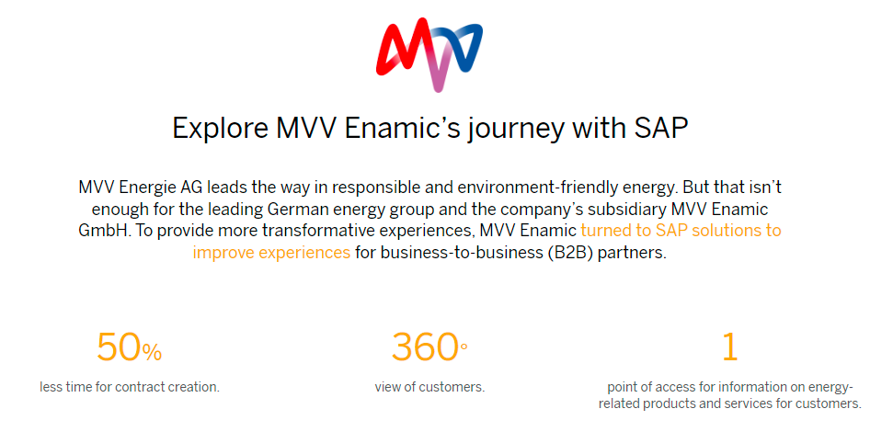
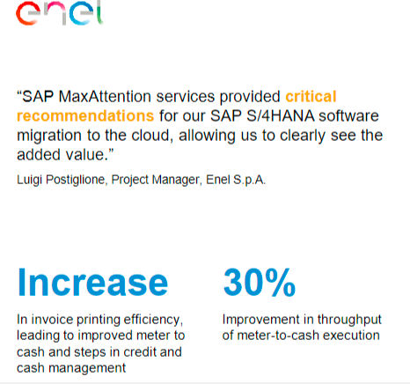
Use CASES
MVV Enamic: Building the energy sales and marketing platform of the future
Enel: Innovating and Improving Operations to Bring Energy to More People

Slide 11
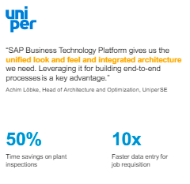
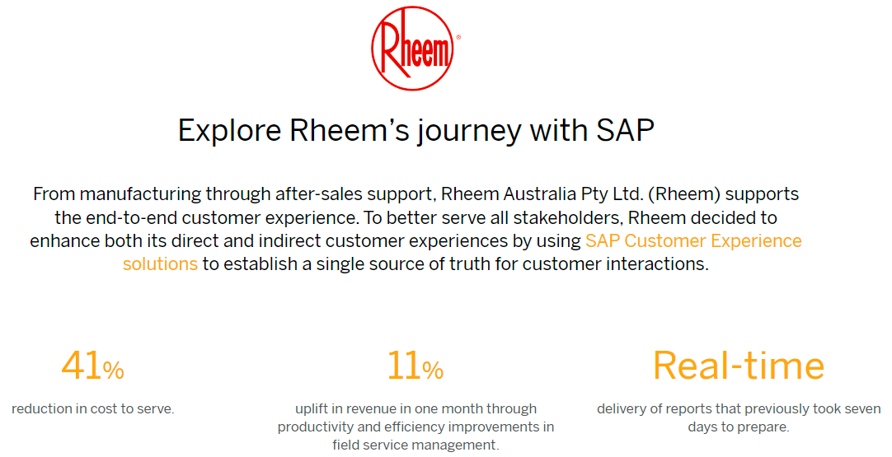
Use CASES
Uniper : Extending and Automating Processes
From the Plant, to the Field, to the Back Office
Rheem: Enhancing customer experiences with an integrated, cloud-based platform

